Slide 1
Introduction to Software Development Aspects
Chapter2-Software Engineering by Ian Sommerville

Slide 2
Software Engineering
Software engineering is an engineering discipline that is concerned with all aspects of software production from the early stages of system specification to maintaining the system after it has gone into use.

Slide 3
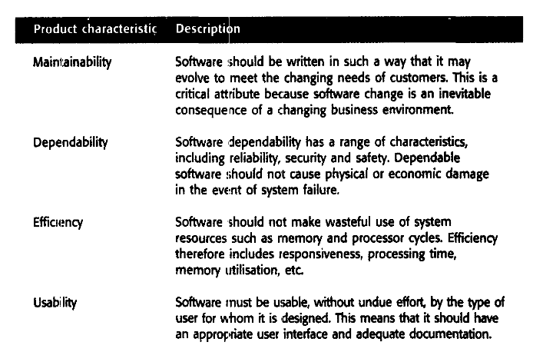
Characteristics of A GOOD SOFTWARE

Slide 4
The Software Development Process
"It is better not to proceed at all, than to proceed without method." --Descartes
"Stop the life cycle--I want to get off"
-- Barry Boehm

Slide 5
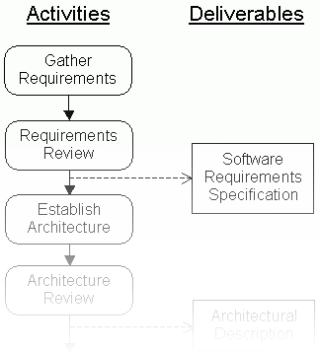
A Software Development Process Organizes the Activities of Software Development
. . . . . .
Review
System
Manage
Risks
Test
Prototype
Create
Unit
Test
Design
Gather
Implement
Requirements
Correct
Integrate
Mistakes
Rework
Developing software without a defined process is chaotic and inefficient
Following a defined process makes software development more orderly, predictable and repeatable

Slide 6
A series of steps taken to produce an intended output
What is a Process

Slide 7
Why are Process so Important
Impose consistency and structure on a set of activities
Guide us to understand, control, examine, and improve the activities
Enable us to capture our experiences and pass them along

Slide 8
Common Processes
Waterfall
Prototyping
V-Model
Incremental
Iterative
Spiral
Agile Development

Slide 9
Waterfall Model
The waterfall model is a breakdown of project activities into linear sequential phases, where each phase depends on the deliverables of the previous one and corresponds to a specialization of tasks.
This takes the fundamental process activities of specification, development, validation, and evolution and represents them as separate process phases such as requirements specification, software design, implementation, testing, and so on.

Slide 10
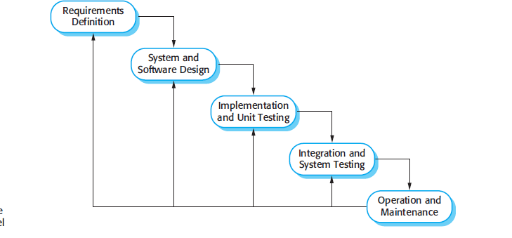
Waterfall Model

Slide 11
When Waterfall Model is USED
Small scale Project
Clearly defined requirements
Technology Understood

Slide 12
Prototyping Model
developers assess alternative design strategies
(design prototype)
users understand what the system will be like (user interface prototype)

Slide 13
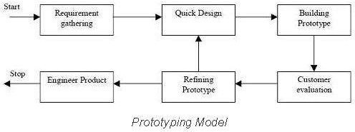
Typical Representation of Prototype model

Slide 14
V Model
A variation of the waterfall model
Uses unit testing to verify procedural design
Uses integration testing to verify architectural (system) design
Uses acceptance testing to validate the requirements
If problems are found during verification and validation, the left side of the V can be re- executed before testing on the right side is re-enacted

Slide 15
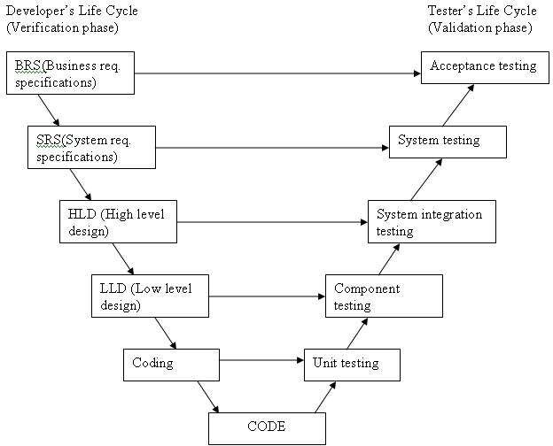
Representation of V Model

Slide 16
When to use V Model
The V-shaped model should be used for small to medium sized projects where requirements are clearly defined and fixed.
The V-Shaped model should be chosen when ample technical resources are available with needed technical expertise.

Slide 17
Incremental Model
Incremental development is based on the idea of developing an initial implementation, exposing this to user comment and evolving it through several versions until an adequate system has been developed

Slide 18




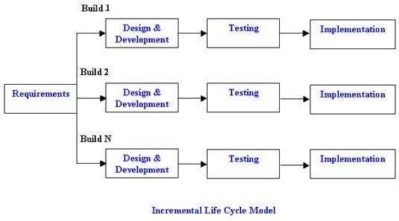

Slide 19
When to use Incremental Model
Requirements of the complete system are clearly defined and understood.
Major requirements must be defined; however, some details can evolve with time.
There is a need to get a product to the market early.
A new technology is being used
Resources with needed skill set are not available
There are some high risk features and goals

Slide 20
Iterative Model
no start with a full specification of requirements.
development begins by specifying and implementing just part of the software, which can then be reviewed in order to identify further requirements.
process is then repeated, producing a new version of the software for each cycle of the model.

Slide 21

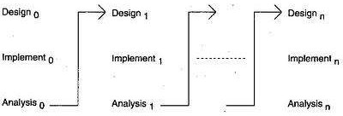

Slide 22
Agile Project Management
The principal responsibility of software project managers is to manage the project so that the software is delivered on time and within the planned budget for the project.
They supervise the work of software engineers and monitor how well the software development is progressing.
Notes:
Agile Core principles :
individuals and interactions over processes and tools;
working software over comprehensive documentation;
customer collaboration over contract negotiation; and.
responding to change over following a plan.

Slide 23
Scrum
The Scrum approach (Schwaber, 2004; Schwaber and Beedle, 2001) is a general agile method but its focus is on managing iterative development rather than specific technical approaches to agile software engineering.
Scrum does not prescribe the use of programming practices such as pair programming and test-first development. It can therefore be used with more technical agile approaches, such as XP, to provide a management framework for the project

Slide 24
Phases of Scrum
There are three phases in Scrum.
The first is an outline planning phase where you establish the general objectives for the project and design the software architecture
Followed by a series of sprint cycles, where each cycle develops an increment of the system.
Finally, the project closure phase wraps up the project, completes required documentation such as system help frames and user manuals, and assesses the lessons learned from the project.

Slide 25
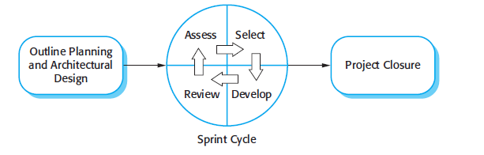
Scrum cont..

Slide 26
